Slide 1
Pumps and Turbines
Ramu Rajendran

Slide 2
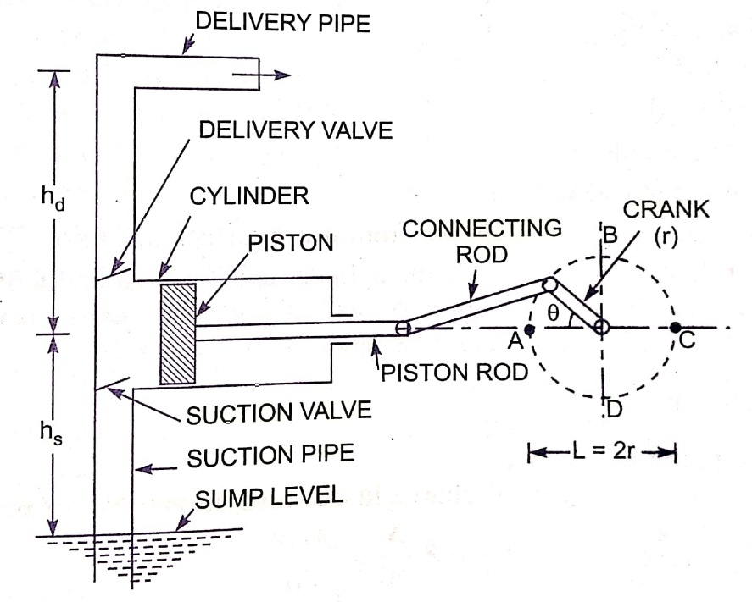
Reciprocating Pump

Slide 3
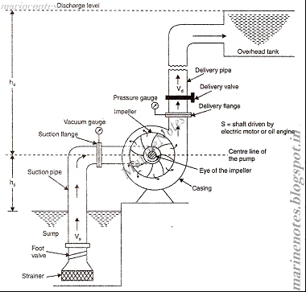
Centrifugal Pump

Slide 4
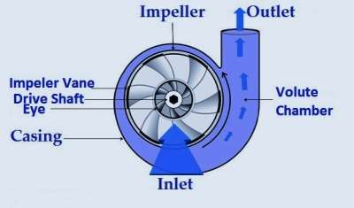
Closer look at the casing
https://www.youtube.com/watch?v=BaEHVpKc-1Q

Slide 5
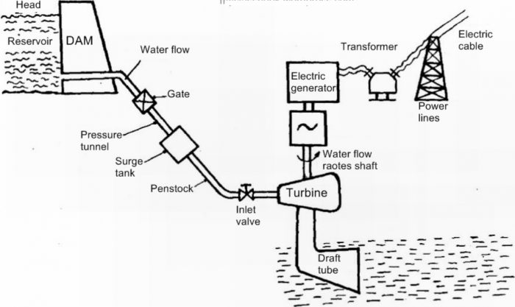
Hydro electric power plant – (Not in syllabus)

Slide 6
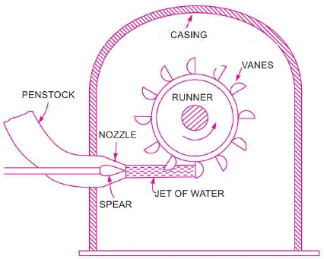
Pelton Wheel Turbine

Slide 7
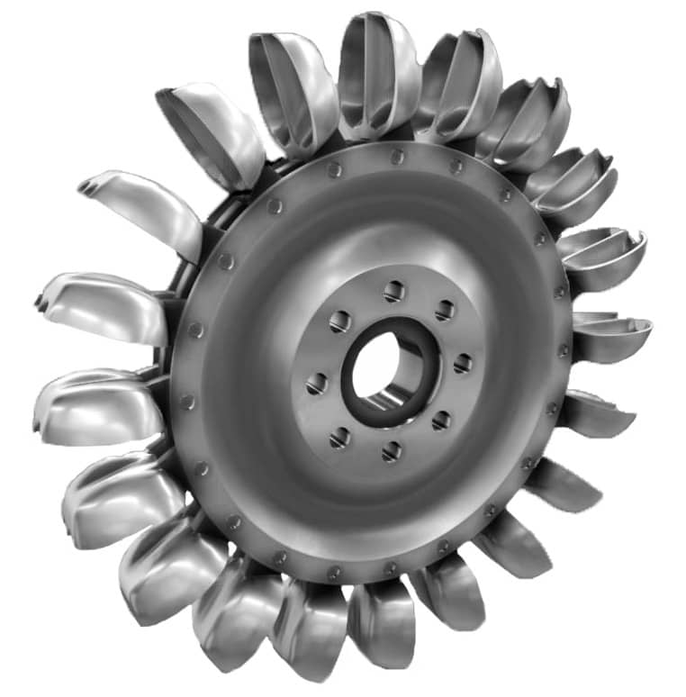
Closer look at Pelton wheel

Slide 8
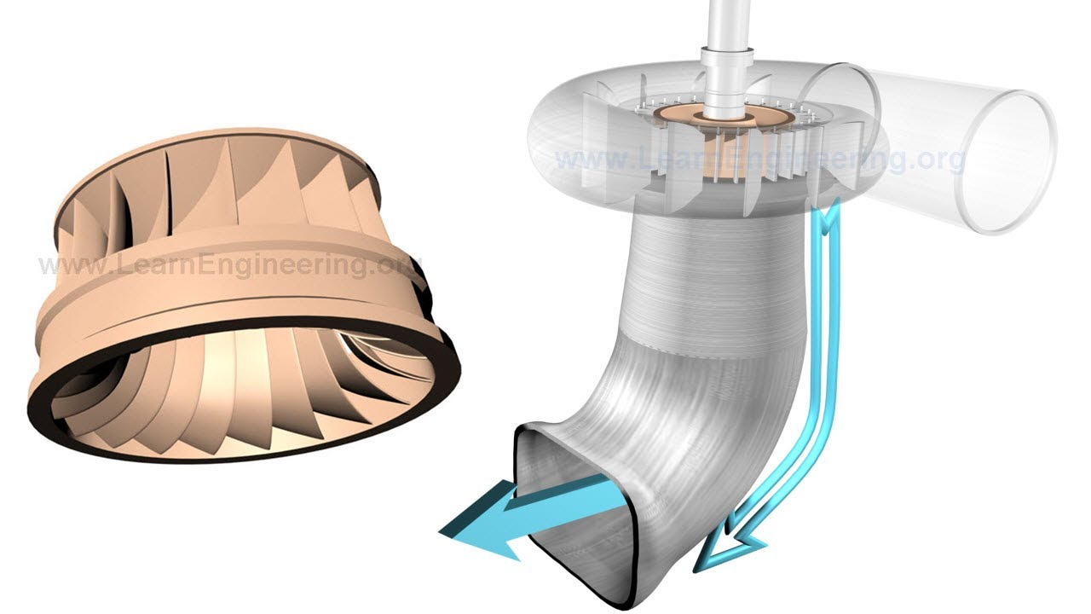
Francis Turbine

Slide 9
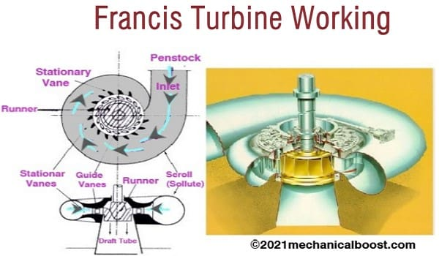

Slide 10
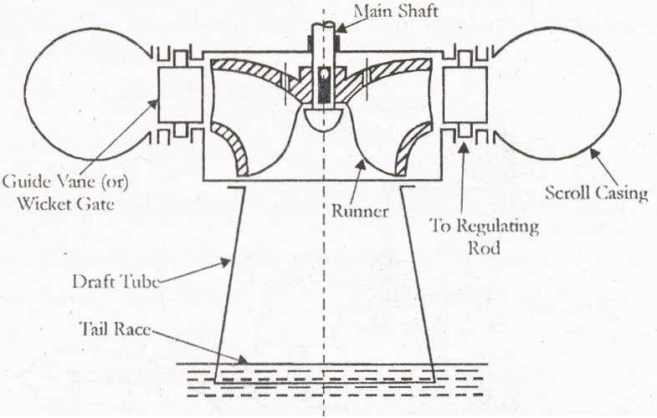

Slide 11
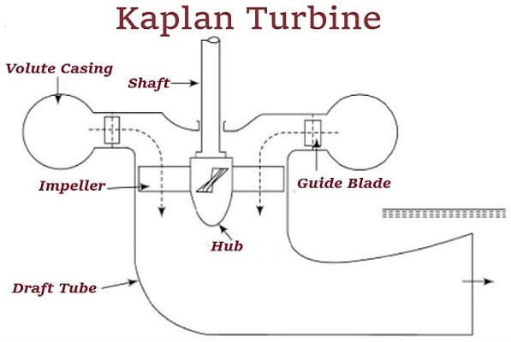

Slide 12
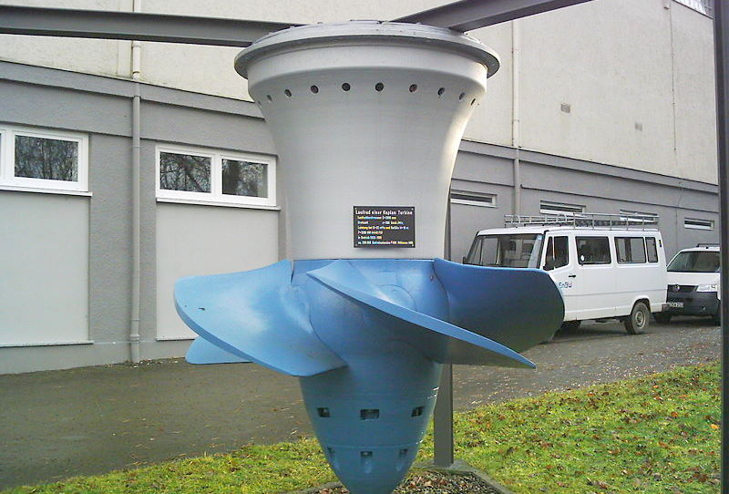

Slide 13
Sl. No | Criteria | Pelton Turbine | Francis Turbine | Kaplan Turbine
1 | Type | Pelton turbine is an impulse type water turbine | Francis Turbine is an inward flow reaction turbine. | Kaplan turbine is a propeller type reaction turbine.
2 | Head | It is used for high heads ranging from 250 to 1000m | The operating water head of a Francis turbine ranges from 40 to 600m. | It is used for low heads ranging from 10 to 70 metres
3 | Runner | The diameter of the runner varies from 0.8 to 0.6m | The diameter of the runner varies between 0.91 to 10.6 | The diameter of the runner varies between 2 to 11 metres
4 | Direction of Flow of Water Through the Blades | The flow of water is tangential to the runner. Hence it is also called as tangential flow impulse turbines | The flow of water through the blades combines both radial and axial flow. | The flow of water is axial through the blades.
5 | Power Generation | Power generated is about 400MW | The power generated by a Francis turbine is about 800MW | The output power obtained varies from 5 to 200 MW
6 | Speed | The rate of speed in a Pelton turbine changes from 65 to 800rpm | The speed of the turbine ranges from 75 to 1000rpm | The rotational speed varies from 69.2 to 429 rpm.
7 | Discharge Required | The required discharge for the working of a Pelton turbine is low. | Medium discharge is required for the working of the Francis turbine. | A Kaplan turbine requires high discharge for efficient working.
8 | Type of Energy | The Pelton turbines uses kinetic energy and converts into mechanical energy | The Francis turbine converts potential energy into mechanical energy | The Kaplan Turbine uses both kinetic and potential energy, which then is converted into mechanical energy.
9 | Efficiency | The efficiency of a Pelton turbine is about 85% | The efficiency of a Francis turbine is about 90%. | The Kaplan turbine gives higher efficiency about 90%

